Slide 1
Overview
Introduction
Data preparation
Exploratory analysis
Model deployment
Findings & Suggestions
Potential Improvements

Slide 2

Predict Customer Success
Focus:
B2B, local restaurants in Utah
Focus:
B2B, local restaurants in Utah
Target Variables
Longevity
Total Gross Profit Dead Net
Target Variables
Longevity
Total Gross Profit Dead Net
Prediction Models
Patterns, trends, relationships
Prediction Models
Patterns, trends, relationships

Slide 3
Sales Data
Change data type
MAX & MIN_POSTING_DATE converted to Date
Change data type
MAX & MIN_POSTING_DATE converted to Date
Group customer sales records by CUSTOMER_NUMBER_BLINDED
Modify MAX & MIN _POSTING_DATE
Extract total values (GROSS_PROFIT_DEAD NET, DISCOUNT, INVOICE_PRICE, etc.)
Group customer sales records by CUSTOMER_NUMBER_BLINDED
Modify MAX & MIN _POSTING_DATE
Extract total values (GROSS_PROFIT_DEAD NET, DISCOUNT, INVOICE_PRICE, etc.)

Slide 4
Customer Data
Clean data
Simplify ADDRESS_ZIP_CODE to 5 digits
Clean data
Simplify ADDRESS_ZIP_CODE to 5 digits
Filter data
Utah only
Include only “Eating & Drinking” customers from CUSTOMER_ACTIVITY_CLUSTER
Include only “DSD” customers from BUSINESS_TYPE_EXTENSION_DESCRIPTION
Filter data
Utah only
Include only “Eating & Drinking” customers from CUSTOMER_ACTIVITY_CLUSTER
Include only “DSD” customers from BUSINESS_TYPE_EXTENSION_DESCRIPTION

Slide 5
American Community Survey (2017-2021)
Population
Household income
Household size
Year structure built
Housing costs
Rent
Selected owner costs
Number of cars used to commute
Number of households without internet

Slide 6
Customer Longevity Calculation
Maximum Posting Date
–
Onboarding Date
=
Customer Longevity

Slide 7
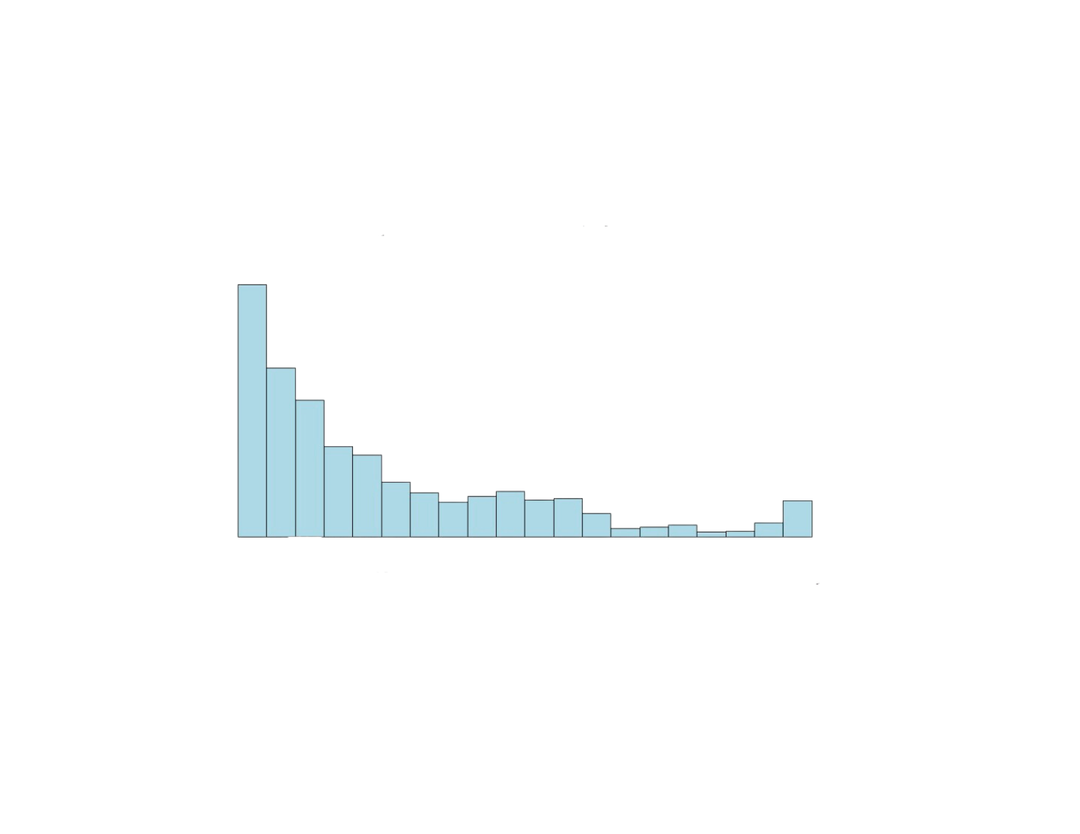
Customer Longevity Distribution
25000
Average: 7.8 VS 10.5 years
Median: 4.6 VS 6.5 years
Customer Count
15000
5000
0
0
10
20
30
40
Longevity (in years)

Slide 8
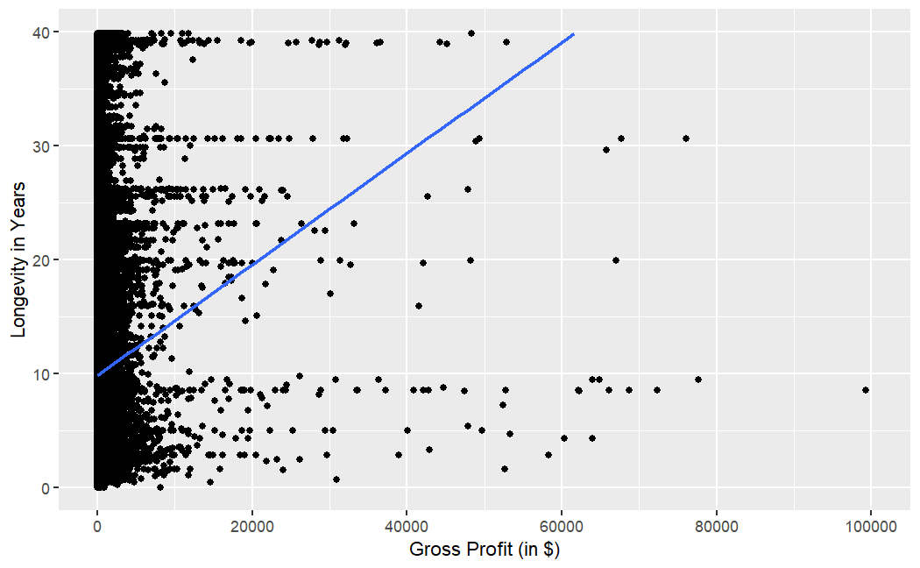
Customer Longevity vs. Profit
The relationship between customer longevity and gross profit is not obvious by plotting

Slide 9
Customer Average Lifetime Value
Revenue per customer
(2021 and 2022)
$4.99K
Average customer longevity
7.85 years
4.99 / 2 * 7.85 ≈ 19.6k
$19.6K

Slide 10
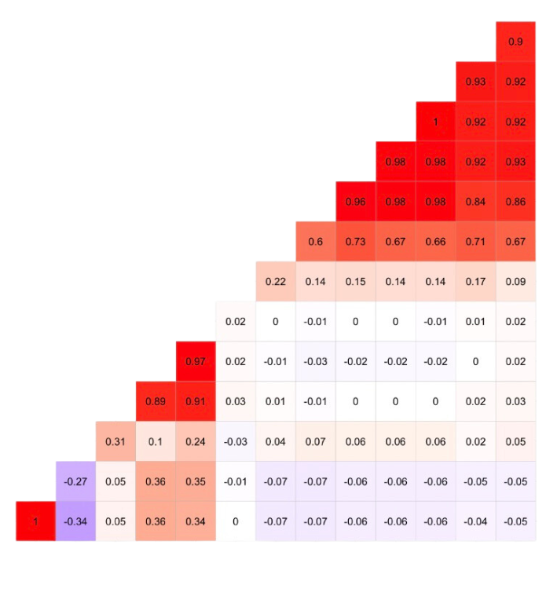
Numeric correlations
GROSS_PROFIT_DEAD_NET
Customer longevity is not highly correlated with any other variables
Gross profit is highly correlated with dead net, invoice price, discount, etc.
DEAD_NET
INVOICE_PRICE
DISCOUNT
COGS
NUM_OF_TRANSACTIONS
LONGEVITY
MED_HOUSING_COST
MED_GROSS_RENT
MED_INCOME
AVG_HOUSEHOLD_SIZE
TOTAL_POP
MONTHLY_OWNER_COSTS
COGS
TOTAL_POP
INVOICE_PRICE
LONGEVITY
DISCOUNT
DEAD_NET
MED_HOUSING_COST
MED_INCOME
MED_GROSS_RENT
AVG_HOUSEHOLD_SIZE
NUM_OF_TRANSACTIONS
GROSS_PROFIT_DEAD_NET

Slide 11
Two models
Predict customer longevity
Using support vector regression
Predict customer gross profit
Using gradient boosting regression

Slide 12
Predicting customer longevity
Numeric prediction (years)
Method generalizes well with highly dimensional data
Simple and stable implementation
Best fit R² = 0.28
Needs improvement

Slide 13
Predicting customer gross profit
Method captures complex patterns
Feature selection
Best fit R² = 0.84
Includes discount as predictor

Slide 14
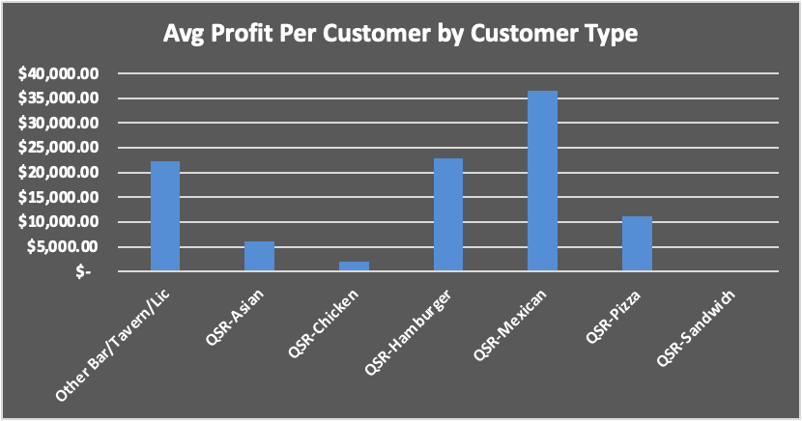
Findings & Suggestions
Provide promotions or discounts for customers with high average profit

Slide 15
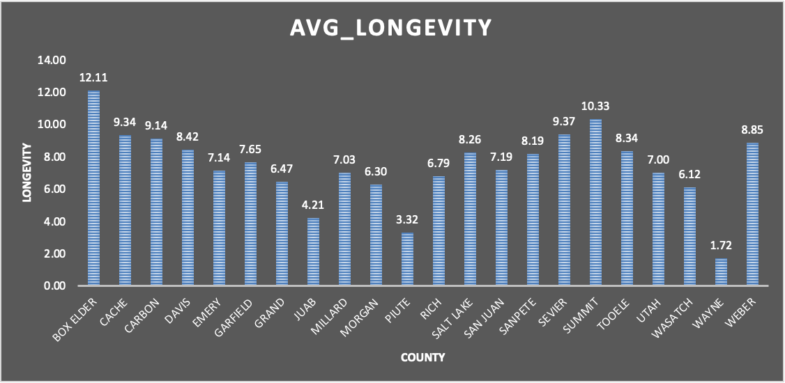
Findings & Suggestions
1. BOX ELDER 12.11 years 2.SUMMIT 10.33 years
3.SEVIER 9.37 years
4.CACHE 9.34 years
5.CARBON 9.14 years
Years
Ogden Sales Office

Slide 16
Improvements
Find data google review (address/name…)
Find data google review (address/name…)
Customer Clustering
Customer Clustering
Different ACS variables
Different ACS variables

Slide 17
Questions?

